Slide 1
Path Segment Encapsulation in SRv6 draft-li-6man-srv6-path-segment-encap-00
_______________________________________________________________________
Presenter: Fengwei Qin (China Mobile)
Cheng Li/Weiqiang Cheng/Dhruv Dhoby/Zhenbin Li
IETF#105
________
Notes:
draft-li-6man-srv6-path-segment-encap-00

Slide 2
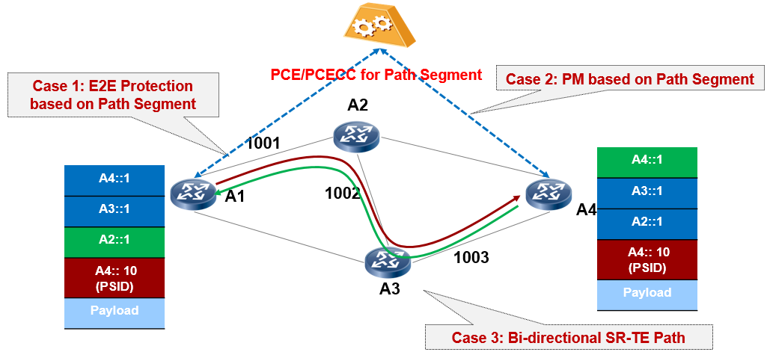
SRv6 Path Segment
SRv6 Path Segment is proposed in draft-li-spring-srv6-path-segment.
A SRv6 Path Segment is inserted as the last segment in the SID list without affecting the original SID list.

Slide 3
Path Segment Encapsulation in SRv6
Depending on the use case, an SRv6 Path Segment can identify:
an SRv6 path within an SRv6 domain
a Candidate-paths or a SID-List in a SRv6 Policy.
an SRv6 Policy
To indicate the existence of Path Segment in the SRH, a P-bit is defined.
P-bit: set when SRv6 Path Segment is inserted. It SHOULD be ignored when a node does not support SRv6 Path Segment processing.
The SRv6 Path Segment MUST appear only once in a SID list, and it MUST appear at the last entry.
The SRv6 Path Segment MUST NOT be copied to the IPv6 destination address.
Next Header | Hdr Ext Len |  | Routing Type | Segment Left
Last Entry | Flags | P | Tags
Segment List[0]
Segment List[1]
…
Segment List[n-1]
SRv6 Path Segment
SRv6
SID List
Notes:
The SRv6 Path Segment MUST appear only once in a SID list, and it MUST appear at the last entry, so the SRv6 Path Segment MUST NOT be copied to the IPv6 destination address. The format of the SRv6 Path Segment follows the format described in section 2.2.

Slide 4
Format of SRv6 Path Segment
This document defines two formats of SRv6 Path Segment.
SRv6 Path Segment: Locator and Local ID
where the LOC part identifies the egress node that allocates the Path Segment,
the FUNCT part is an unique local ID to identify an SRv6 Path towards to the egress on the egress
SRv6 Path Segment: Global ID
the SRv6 Path Segment will not be copied to the IPv6 Destination Address, so the SRv6 Path Segment ID can be allocated from an independent 128-bits ID Space.
In this case, a new table should be maintained at the node for SRv6 Path Segment.
Locator | Function ID
128 Bits
Global ID/PSID
128 Bits

Slide 5
Processing of SRv6 Path Segment
An SRv6 Path Segment can be allocated through several ways, such as
PCEP [I-D.li-pce-sr-path-segment]
BGP [I-D.li-idr-sr-policy-path-segment-distribution]
When the SRv6 Path Segment is allocated by the egress, it MUST be distributed to the ingress node.
An SRv6 Path Segment may be distributed to the SRv6 nodes along the path depending on use cases.
When the SRv6 Path Segment is used, the following rules apply:
The SRv6 Path Segment MUST appear only once in a SID list, and it MUST appear at the last entry.
Only the one that appears at the last entry in the SID list will be processed. SRv6 Path Segment appears at other location in the SID list will be treated as an error.
When an SRv6 Path Segment is inserted, the SL MUST be initiated to be less than the value of Last Entry, and will not point to SRv6 Path Segment.
The SRv6 Path Segment MUST NOT be copied to the IPv6 destination address.
Penultimate Segment Popping (PSP) MUST be disabled.
The ingress needs to set the P-bit when an SRv6 Path Segment is inserted in the SID List.
The specific SRv6 Path Segment processing depends on use cases, and it is out of scope of this document.

Slide 6
Next Step
Comments are welcome!
Discuss the format of SRv6 Path Segment.
Notes:
SR Bi-directional Path Sub-TLV

Slide 7
Thank you
================

Slide 8
Motivation
In SR-MPLS, no label or only the last label may be left in the MPLS label stack when the packet reaches the egress node. Thus, the egress node cannot determine from which SR path the packet comes.
To support use cases like end-2-end 1+1 path protection, bidirectional path correlation or performance measurement(PM), the ability to implement path identification is the pre-condition
draft-ietf-spring-mpls-path-segment introduces a new Path Segment to unique identify an SR-MPLS.
In SRv6, the segment list may not be a good key to identify an SRv6 path as the length of segment list is too long and flexible.
In reduced mode, the first Segment is not inserted in the SRH, so the path info is incomplete, and a path ID is needed to identify the path.
An SRv6 Path Segment that can identify an SRv6 path, Candidate-paths or SRv6 Policy is proposed in draft-li-spring-srv6-path-segment-02.
This document defines the encapsulation of SRv6 Path Segment

